Slide 1
Tic tac toe game

Slide 2
Introduction:
What is Tic-Tac-Toe:
Tic-Tac-Toe, Also referred to as "Noughts and Crosses," Tic-Tac-Toe is a classic game that is cherished for its appeal as a strategy game.
How It Works:
Picture a 3x3 grid where players take turns marking empty spots with X's or O's.
The challenge? Create a line of three X's or O's, horizontally, vertically, or diagonally.
Exploring the Code:
Our journey involves diving into a C# and .NET Framework-based Windows Forms application.
Through buttons, labels, and more, the code transforms the classic board game into a digital experience.
Our adventure into the code will unravel the magic behind Tic-Tac-Toe, exploring elements like class structures, variables, and functions. Let's uncover the secrets that make this classic game tick! 🎮✨

Slide 3
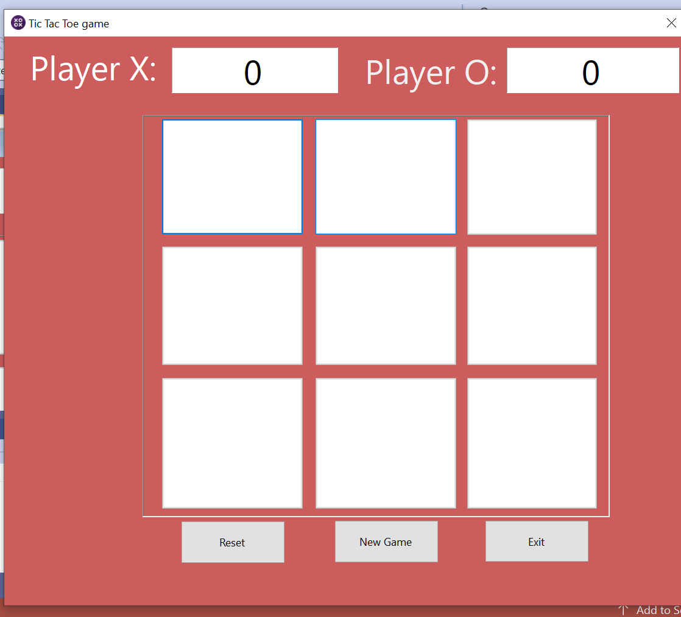
Console IO
Console Input and Output (IO) is essential for command-line apps. It's how users communicate and get feedback. But for graphical apps like Tic-Tac-Toe, Console IO steps back, giving way to visually engaging elements.
GUI Components:
In GUI apps, colorful graphical components replace old-fashioned console interactions
Buttons:
Users can click on these interactive elements to interact with them.
Labels:
Labels are perfect for displaying static text or informative messages.
Textboxes:
By using textboxes, data can be displayed or inputted by users.
This change is best exemplified by our Tic-Tac-Toe implementation. Instead of using console inputs, we use buttons to represent the game board visually. Compared to the traditional console-based method, this switch to GUI components offers a more interactive and engaging platform, greatly improving the user experience. In the realm of Tic Tac Toe, it's all about having fun and having an engaging visual gaming experience. 🎮✨

Slide 4
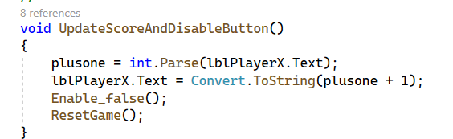
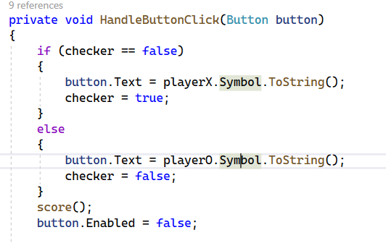
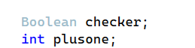
Variables:
Variables are magic boxes that contain important information in the world of programming. I employ variables within the Tic-Tac-Toe game, such as "boolean checker" and "integer plusone," and each one has a distinct role to perform.
Consider variables as the hidden contents' containers in the game. "Plusone" supervises the score, and "Checker" records turns. these unassuming containers play a vital role in maintaining order and keeping the game running smoothly.

Slide 5
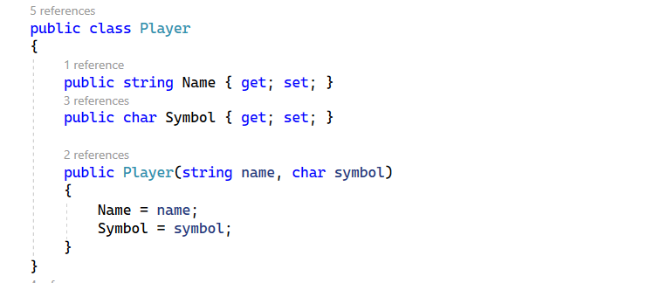
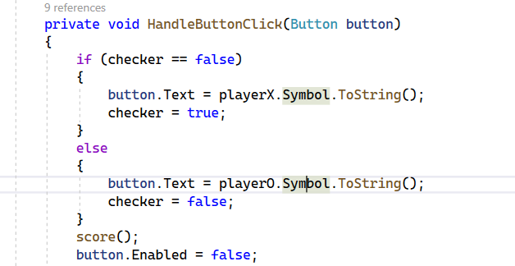
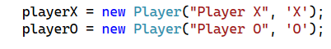

classes
In the Tic Tac Toe game, i’ve employed a concept known as classes, providing a structured way to represent players in the game.
Classes act as templates or blueprints, defining the characteristics and behaviors of objects.
In the HandleButtonClick method, when a button is clicked, it checks the checker variable to determine which player's turn it is.
If it's Player X's turn, the button is marked with 'X'; otherwise, it's marked with 'O'.
This switch between players is done using the playerX and playerO instances of the Player class.
By introducing the Player class, the code becomes more modular and readable. Each player is represented by a distinct object, making the game logic more human-friendly and easier to maintain.

Slide 6
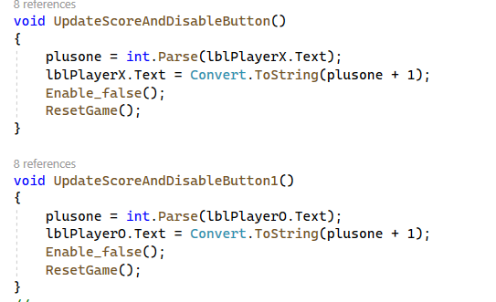

Operators and Selection
Making Decisions with Operators:
In Tic Tac Toe, logical operators act as decision-makers. These operators help determine if conditions are met, such as checking if a player has formed a winning line. For example, in the score method, various logical conditions are used to identify winning combinations, leading to a decision on whether to declare Player X or Player O as the winner.
If-Else Statements:
in the example below, When a button is clicked, HandleButtonClick takes in the button as a parameter, allowing it to mark the spot with 'X' or 'O'. Parameters act like the pieces on the board, defining the action. the if-else statement is that is used in the coding is to help to switch between Player X and Player O turns. If it's Player X's turn (checker == false), the button receives the 'X' symbol; otherwise, it receives 'O'.
Example - Player Turns:
Furthermore within the Tic Tac Toe code, when a player clicks a button, we use logical operators and if-else statements to decide whether it's time for an 'X' or an 'O' to take the stage. The checker variable, acting as a toggle, ensures that the correct symbol is placed on the button

Slide 7
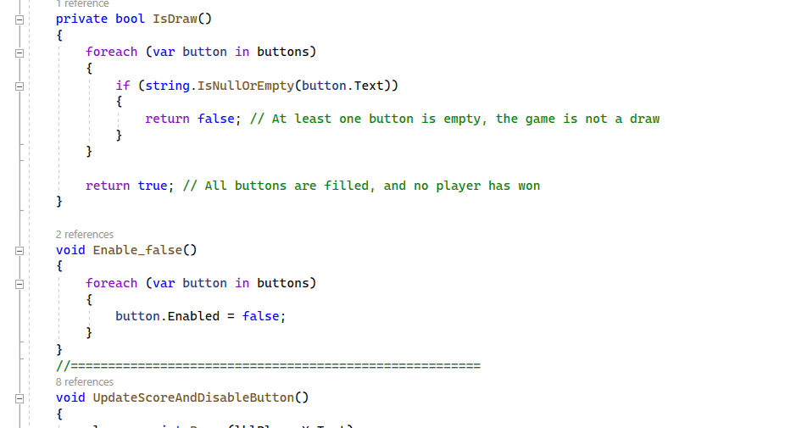

Functions, Return, Parameters
IsDraw:
This function is like a detective checking if the game ends in a draw. It scans through each button, ensuring that none are left unmarked, signaling the end of a match.
in the Tic-Tac-Toe game, the IsDraw function acts as a careful inspector, carefully going over each button on the game board. Its task is to search for empty spaces and, when all buttons are pressed, forcefully declare a draw (returning true) or indicate that the game is still in play (returning false). This feature gives each game of Tic-Tac-Toe a hint of assurance by guaranteeing that a match ends in a friendly draw or with a clear winner.

Slide 8
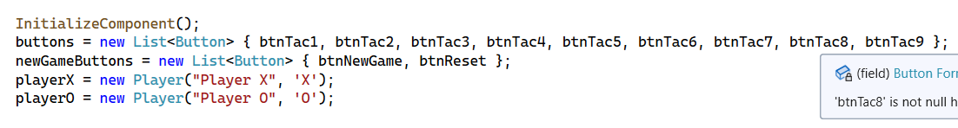
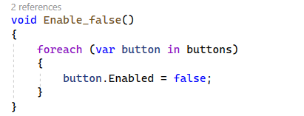
Collection and foreach
In the code, a collection of buttons is created using the List<Button> type, namely the buttons list. This collection conveniently holds references to all the buttons on the Tic Tac Toe game board:
Additionally, I've implemented the 'foreach' loop function, which, when invoked, effectively disables every button on the game board. This is just one instance; similar loops are used for other actions like resetting the game or updating scores.
By leveraging collections and the 'foreach' loop, the code achieves a clean and concise way of managing the various buttons in the Tic Tac Toe interface. This systematic approach not only enhances the readability of the code but also makes it easier to maintain and extend the functionality of the game.

Slide 9
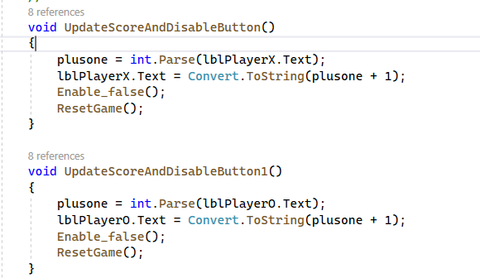
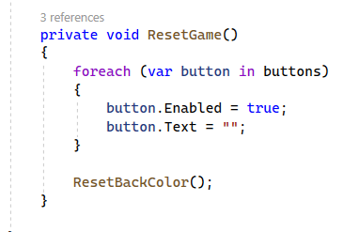
Class Member Functions and Testing
Within the Tic Tac Toe game code, class member functions played a crucial role in me managing the game logic and user interface. The two main member functions: UpdateScoreAndDisableButton and ResetGame.
The purpose of UpdateScoreAndDisableButton is to allow the player score to be update and displaying the player victory when a player wins the game. However, it doesn't end there. It then gracefully deactivates every button, guaranteeing that no further actions may change the result. The stage is then set for a new round with a quick call to ResetGame.
ResetGame performs a similar function in our game. With a clean reset, all the buttons are prepared for the next act. making every button ready for a new act. The text on the buttons is wiped clean, and the background colors are reset for a visually pleasing experience.
Similar to backstage maestros, these roles maintain score and coordinate the ups and downs of each round to guarantee the game plays properly. They are the ideal finishing touch, giving players an enjoyable experience in every game. Additionally, careful evaluation ensures a faultless performance each and every time, much like a well-rehearsed play.

Slide 10
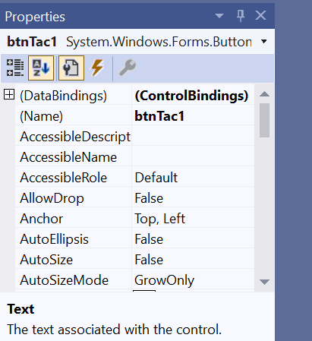
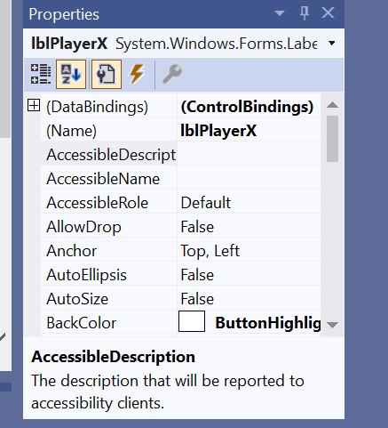
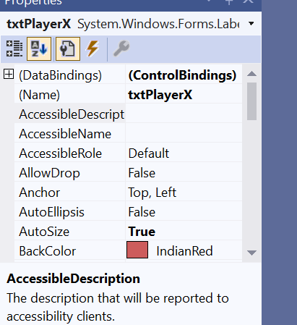
Buttons, Labels, TextBoxes, and Events
Buttons:
These are the clickable squares that form the game grid. Every click triggers essential game logic, thanks to the HandleButtonClick function. It's the very essence of the players' moves and the unfolding drama of each match.
Labels:
Static yet significant, labels like lblPlayerX and lblPlayerO serve as scoreboards. They silently keep track of the players' victories, adding a layer of competition to the game.
TextBoxes:
While not prominently featured in this specific application, TextBoxes can be crucial for text input or dynamic information display in other scenarios. They stand ready for tasks beyond Tic-Tac-Toe.
Events:
Here lies the heartbeat of interaction. Events like btnNewGame_Click and btnExit_Click respond to the players' gestures. They ensure that every click or button press is not just a physical action but a meaningful part of the gaming experience.
In essence, these visual elements and events collaborate to create a visually appealing, functionally sound Tic-Tac-Toe game. They transform a simple grid into a canvas where every move and score update is a stroke in the masterpiece of interactive gaming.

Slide 11
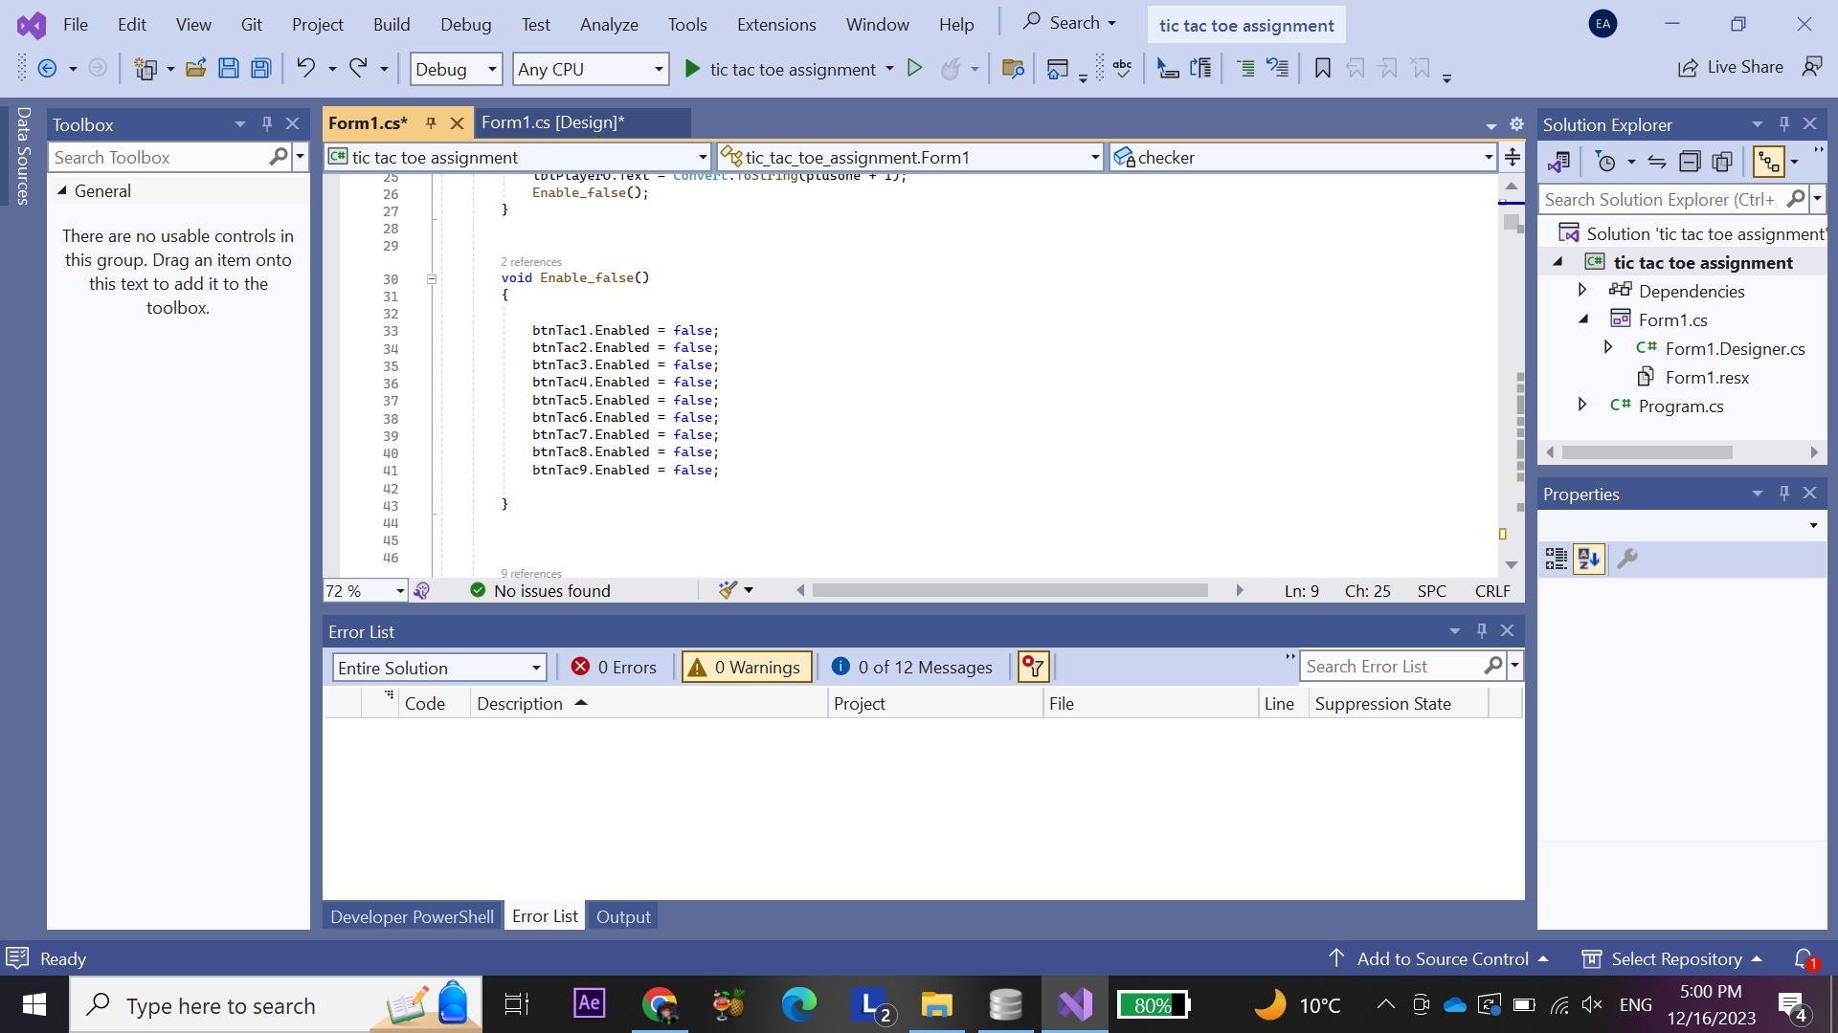

Slide 12
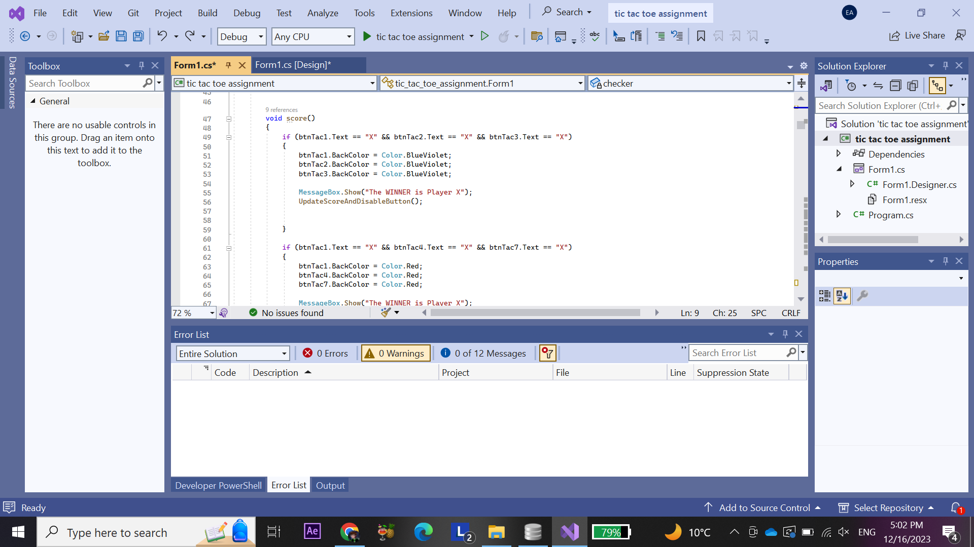

Slide 13
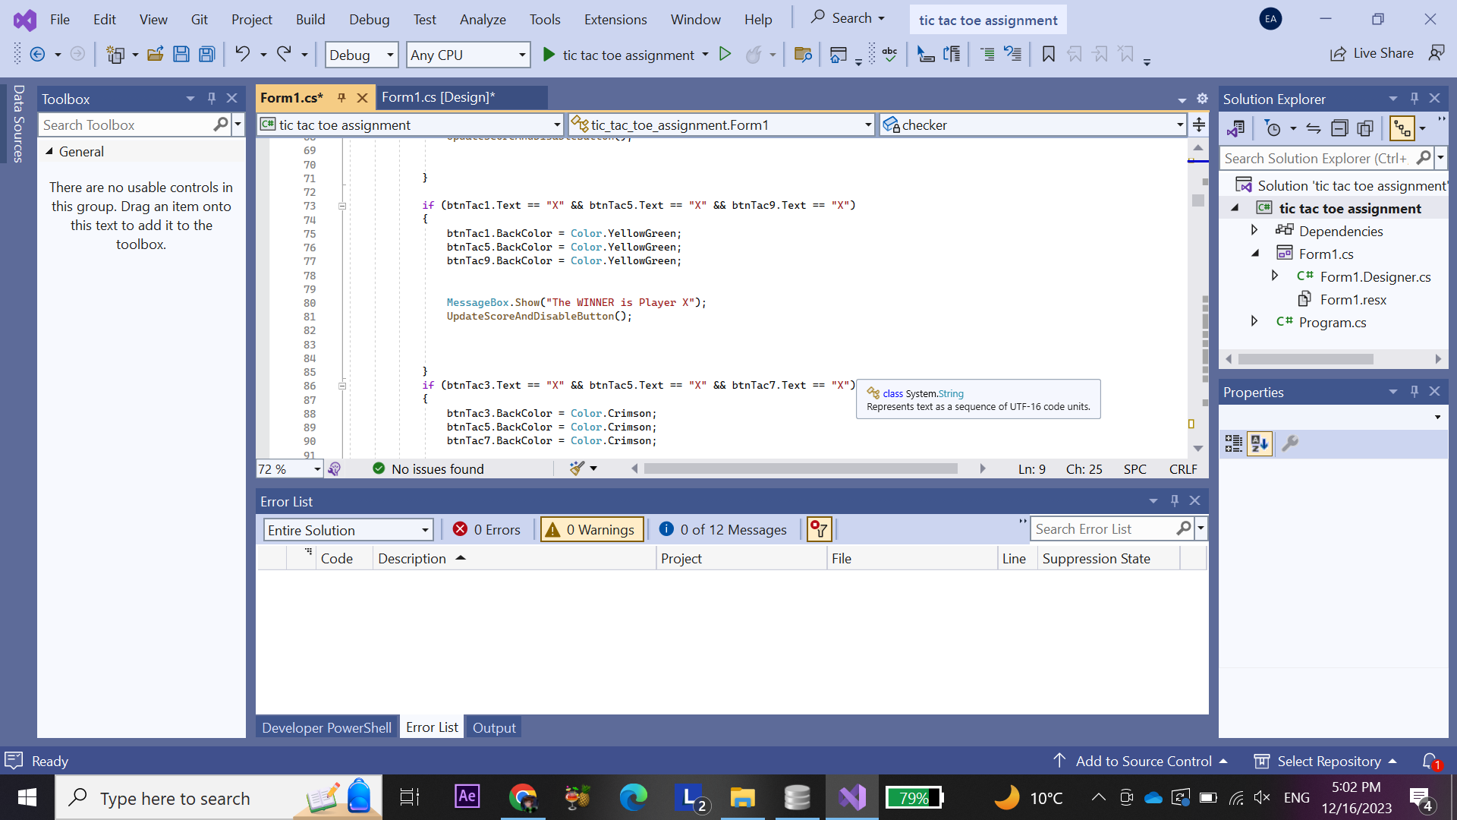

Slide 14


Slide 15


Slide 16
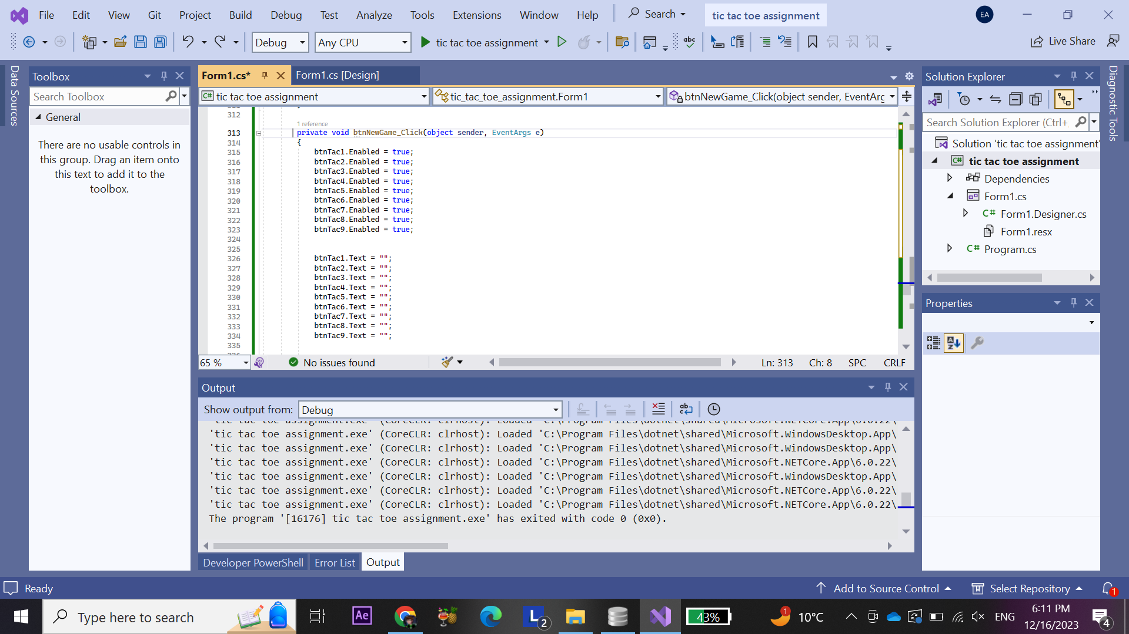

Slide 17


Slide 18
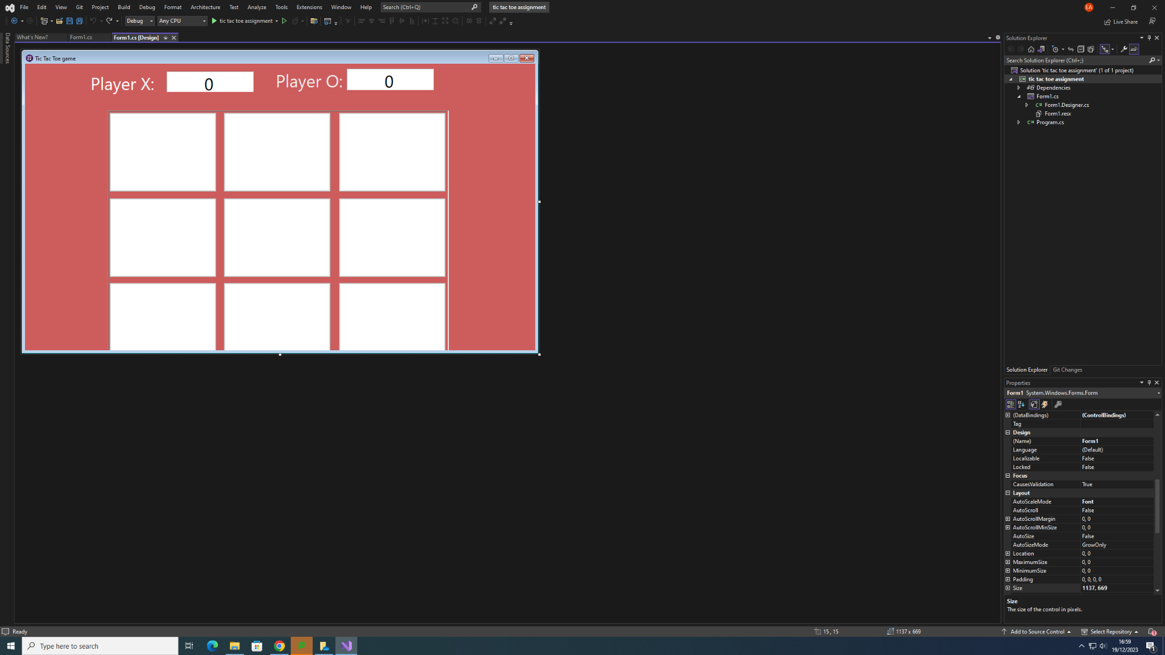

Slide 19
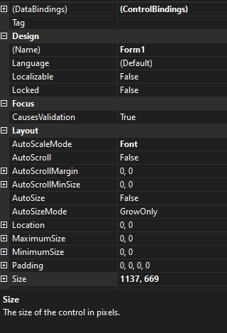

Slide 21
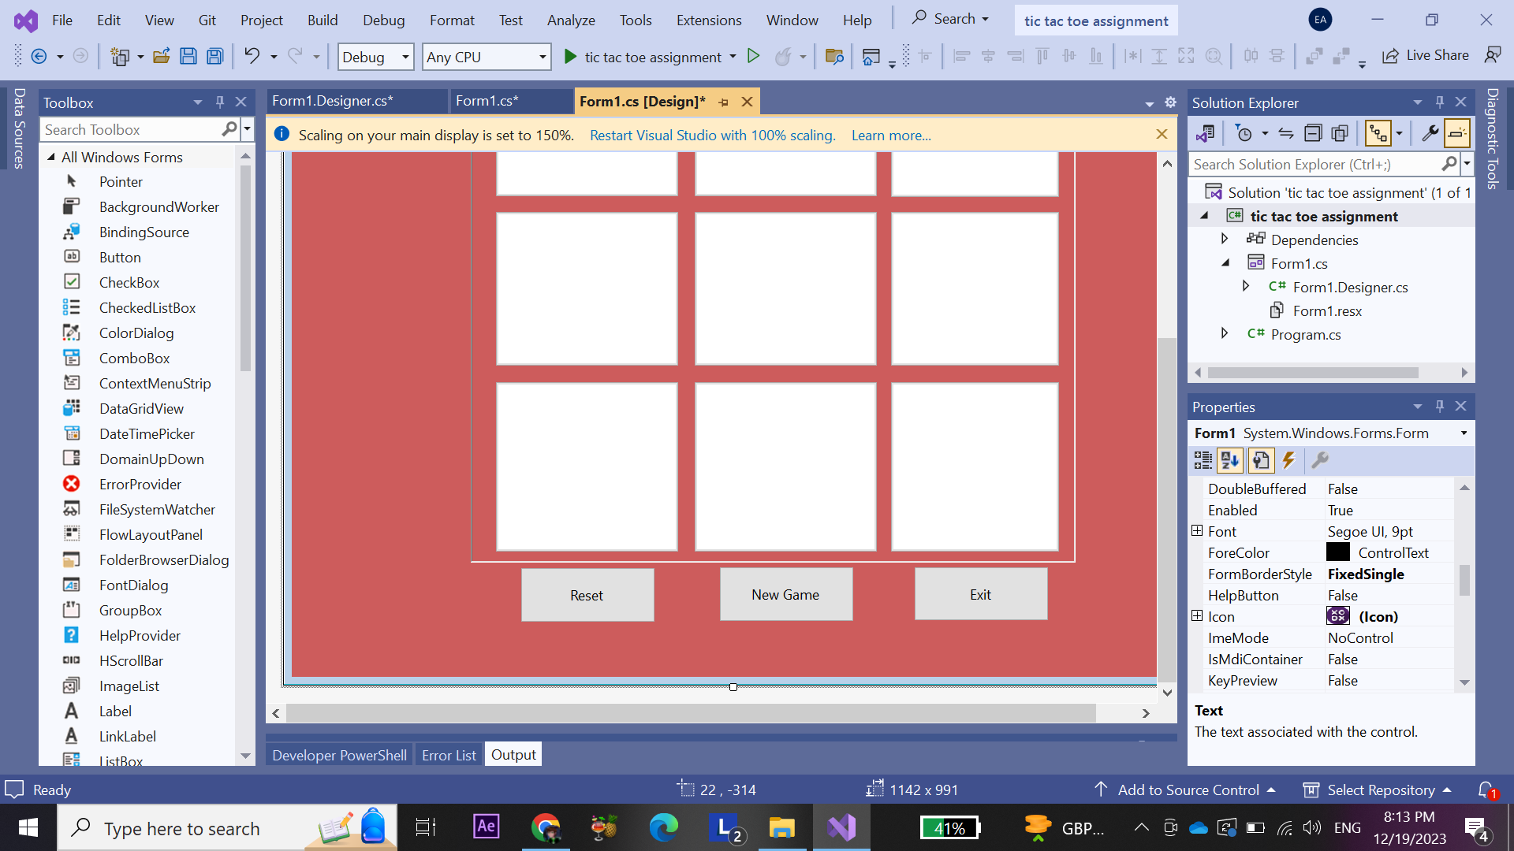

Slide 22
